Slide 1
Week 0 - CYBS 3743: Cyberforensics Fundamental
January 16th 2025
Sungbo Jung

Slide 2
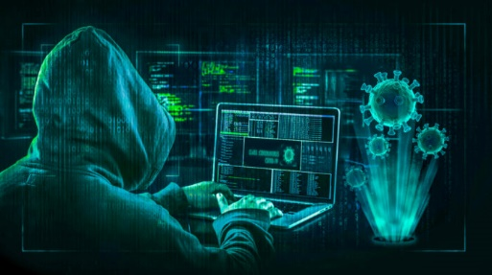
Learner’s Ethics
Do the Right Thing!
Images from https://boardagenda.com/

Slide 3
What is Cyber Forensics?
Forensics
The application of scientific methods to criminal justice. It involves collecting, analyzing, and examining physical evidence.
Cyber Forensics
Cyber forensics is a critical cybersecurity field that involves the identification, preservation, analysis, and presentation of digital evidence.

Slide 4
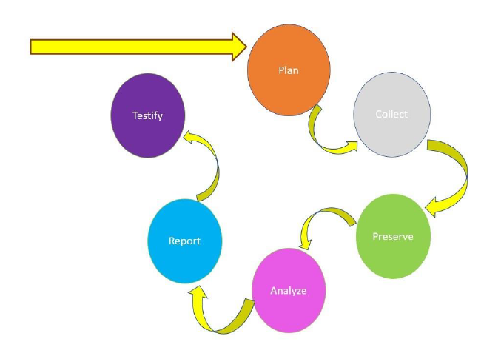
Forensic Procedure

Slide 5
For this Course
We are approaching the Cyber Forensics technically
Memory Forensics
File Systems Forensics
Network Forensics

Slide 6
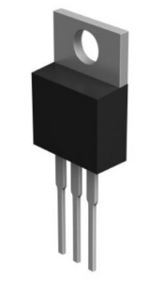

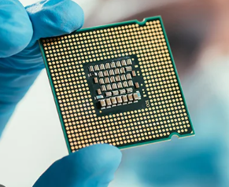
Switch to Semiconductor

Slide 7
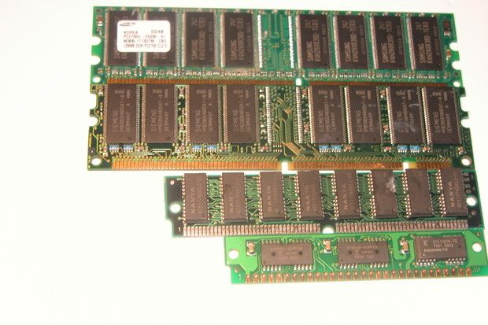
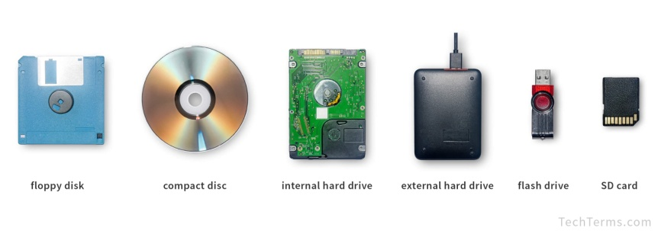
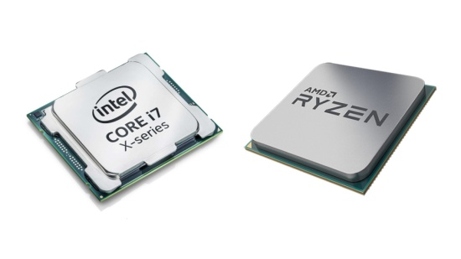
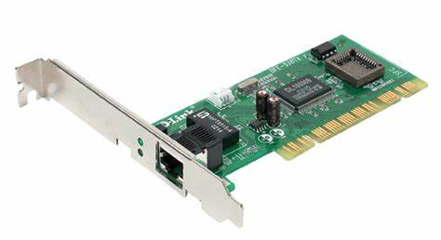
Computer Components
S/W
Data
Socket
User
Application
File
Kernel (O/S)
H/W
RAM
Volatile Memory
Disk Drives
Non-Volatile Memory
CPU
NIC

Slide 8
Practices
Logic – Discrete Math
Data Structure
Scripting / Coding
Text (Binary) Processing

Slide 9
Tools
Hypervisors
Python
.Net framework
Hex editor

Slide 10


